Slide 1

Timber and Touch
Nandni Sharma 4556478
Shivpaul Singh 4542736
Jaskaran Singh 4534519

Slide 2
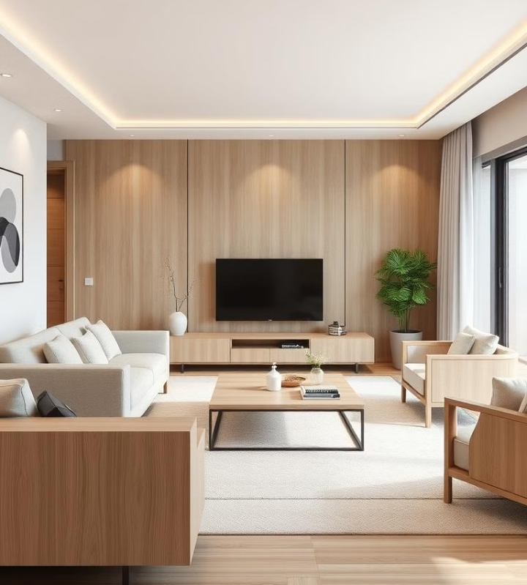

Timber and Touch: Furniture Reimagined
Welcome to the future of furniture, where AI meets craftsmanship. Timber and Touch is revolutionizing the industry with AI-designed furniture that's both beautiful and functional. Join us to discover how we're making furniture personal and sustainable.

Slide 3
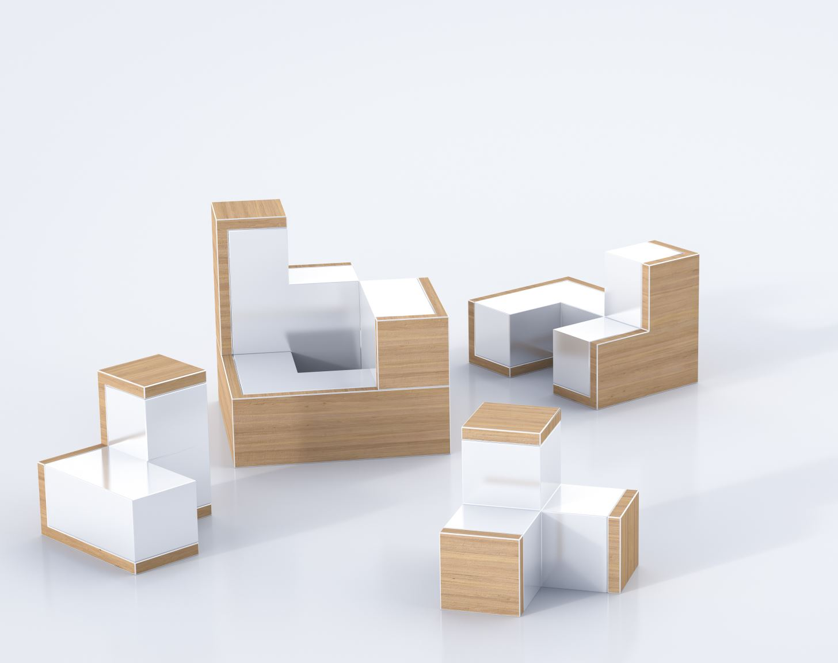
Introduction
Timber and Touch is an innovative mobile application designed to transform the way furniture is designed and manufactured. Combining cutting-edge augmented reality (AR) technology with intuitive tools, the app empowers users to create, customize, and visualize furniture in real time, all from the palm of their hands. Whether you are a DIY enthusiast, a professional designer, or a furniture manufacturer, Timber and Touch offers a seamless platform to bring your creative ideas to life with ease.

Slide 4
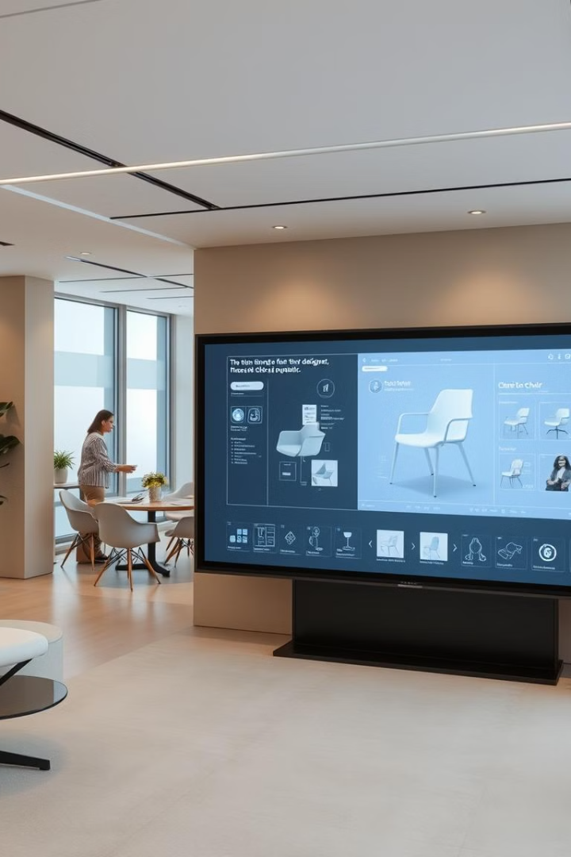
Timber and Touch's Innovative Approach
1
AI-Powered Design
2
Human-Centered Design
Our AI algorithms analyze user preferences, generate design variations, and refine furniture based on feedback.
We prioritize user experience, ensuring comfort, ergonomics, and aesthetic appeal in every design.
3
Sustainable Materials
We utilize responsibly sourced wood and other sustainable materials, minimizing environmental impact.

Slide 5
Case Study
In today’s fast-paced, tech-driven world, furniture design and production have evolved far beyond traditional methods. Consumers are no longer satisfied with off-the-shelf solutions; they seek personalized, functional, and aesthetically pleasing pieces that reflect their unique tastes and lifestyles. However, creating custom furniture has often been a labor-intensive and costly process, making it inaccessible for many. Meanwhile, the global demand for sustainable and eco-friendly products is at an all-time high, with an increasing emphasis on reducing waste and carbon footprints in every industry.
Timber and Touch emerges as a response to these challenges, leveraging modern AI and cutting-edge technology to revolutionize the way furniture is designed, created, and experienced. By merging the timeless beauty of wood craftsmanship with the precision and innovation of technology, Timber and Touch aims to redefine the furniture industry—creating a seamless bridge between tradition and the future.

Slide 6



Sustainability and Environmental Impact
Sustainable Materials
1
Responsibly sourced wood and other sustainable materials are used in manufacturing.
Efficient Manufacturing
2
Minimized waste generation and energy-efficient processes are prioritized.
End-of-Life Solutions
3
Designs prioritize durability and recyclability, promoting circularity and minimizing waste.

Slide 7


Utilizing GitHub for Version Control
Leveraging Jira and Draw.io
Collaborative Development
GitHub promotes open communication and efficient collaboration on design and engineering projects.
Project Management
Visual Collaboration
Jira streamlines project workflows, ensuring smooth collaboration between design, engineering, and manufacturing teams.
Draw.io enables clear communication and visualization of design ideas, facilitating collaborative decision-making.
Version Control
GitHub ensures seamless tracking of design iterations, allowing for easy rollbacks and collaboration.

Slide 8
Jira Overview
JIRA is a project management tool by Atlassian used for agile project management, helping teams plan, track, and manage projects. It supports Scrum and Kanban boards, offering customizable workflows, issue tracking, and reporting.
Projects: Set of work items for a specific goal, customizable with workflows.
Issues: Units of work (bug, task, user story, epic).
Boards: Visual representation of work (e.g., To Do, In Progress, Done).
Backlog: List of tasks and features to be completed, used for sprint planning.
Sprints: Short timeboxes (2-4 weeks) where backlog items are worked on.
Epics: Large features broken down into smaller tasks.
User Stories: Descriptions of features from the user's perspective.
Issue Types: Include Story, Task, Bug, and Epic.

Slide 9

Implementing Scrum Methodology
Sprint Planning
Sprint Reviews
Teams prioritize tasks, estimate effort, and commit to delivering value in short sprints.
Teams demonstrate completed work, gather feedback, and refine future sprints.
1
2
3
4
Daily Scrums
Sprint Retrospectives
Teams meet daily to track progress, discuss roadblocks, and adjust plans.
Teams analyze process improvements, address challenges, and optimize for future sprints.

Slide 10
Working with Scrum Board
Sprint Planning: At the start of each sprint, we select tasks from the backlog and move them to the To Do column on the Scrum board.
Daily Progress: During the sprint, tasks move through stages—To Do, In Progress, and Done—based on their current status. We update our tasks as we work on them.
Collaboration: We communicate regularly, often through daily standups, to discuss blockers, progress, and next steps.
Task Completion: Once tasks are completed, we move them to the Done column, signaling they are finished.
Sprint Review & Retrospective: At the end of the sprint, we review the completed work and reflect on the process to improve future sprints.

Slide 11
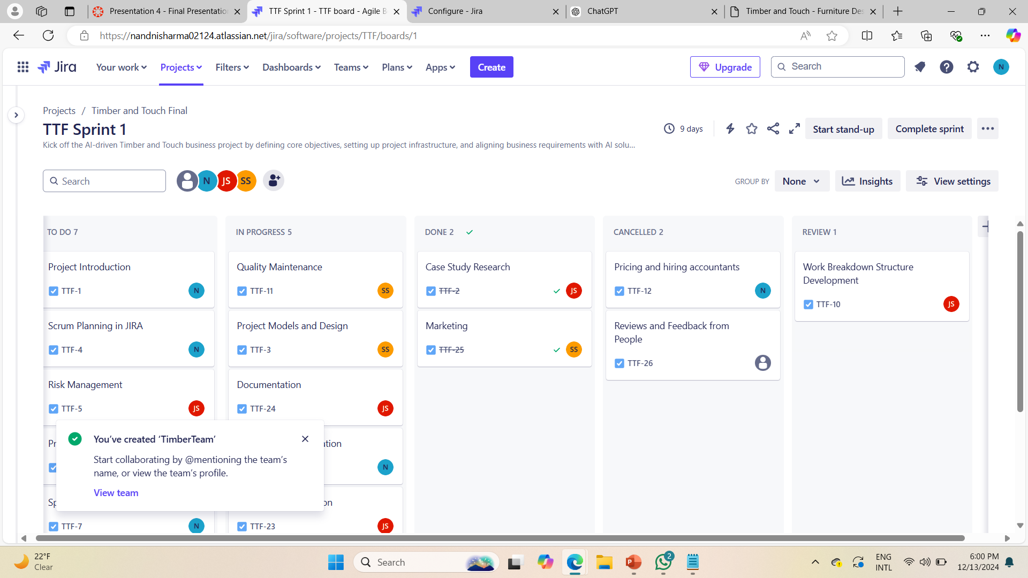
SCRUM BOARD SCREENSHOT

Slide 12
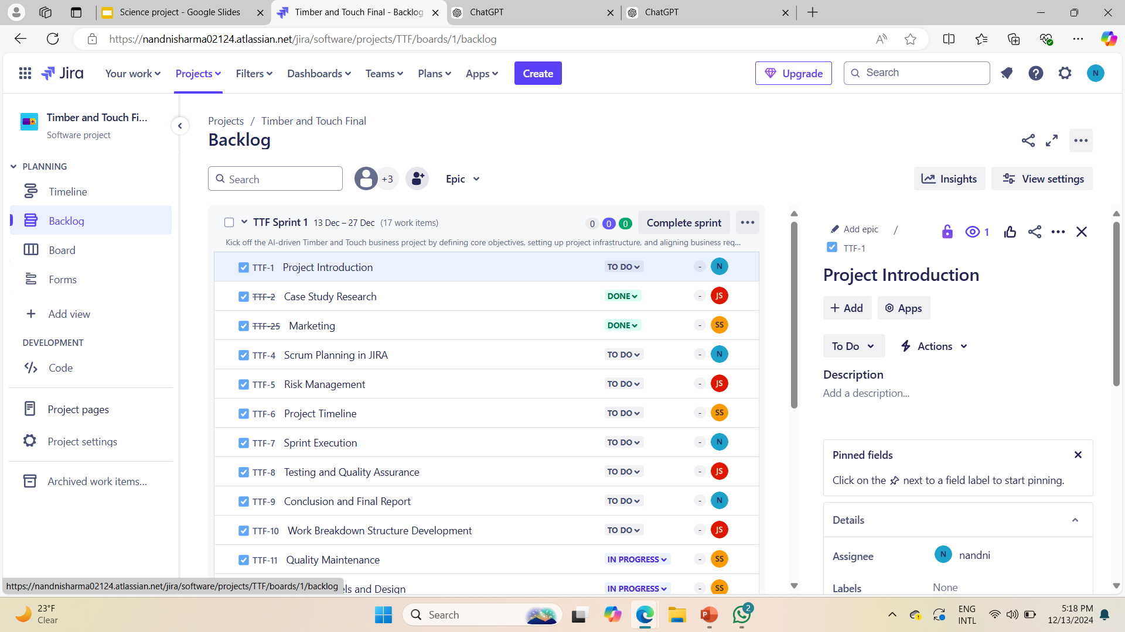
Backlog Due Dates

Slide 13
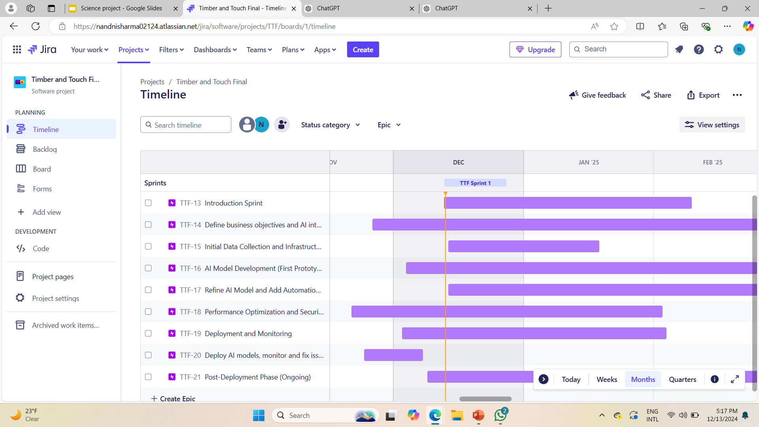
Timeline

Slide 14
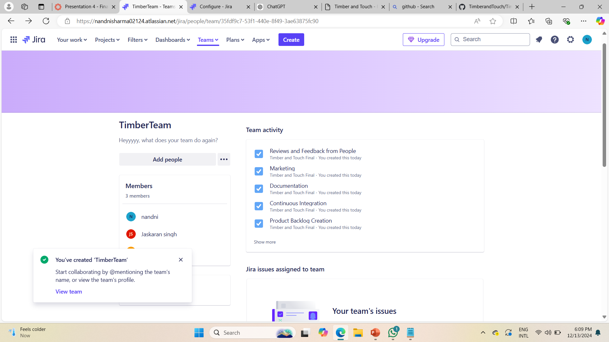
Timber and Touch Team

Slide 15
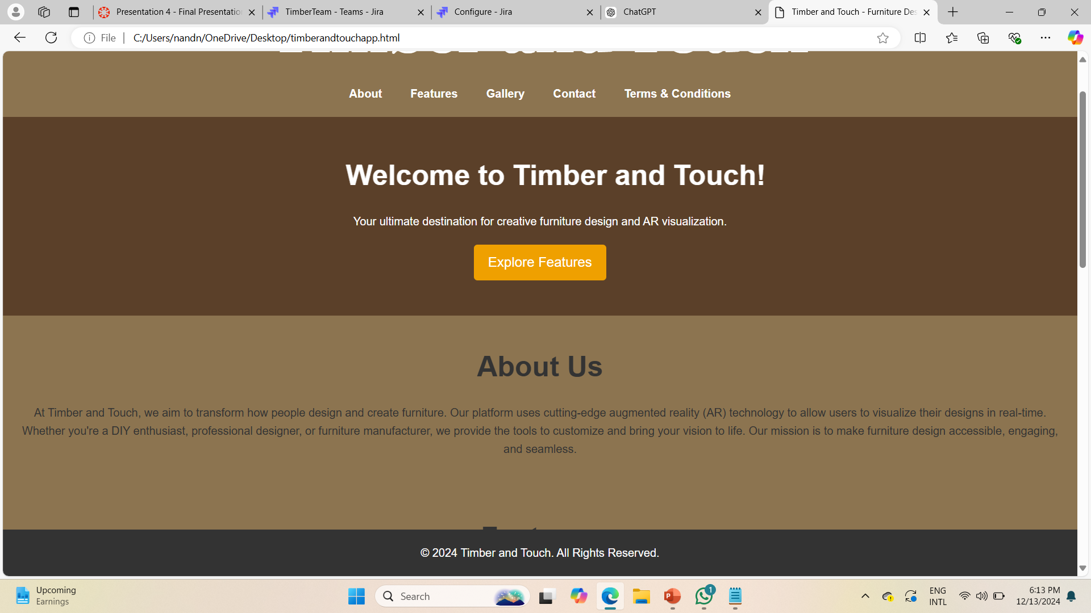
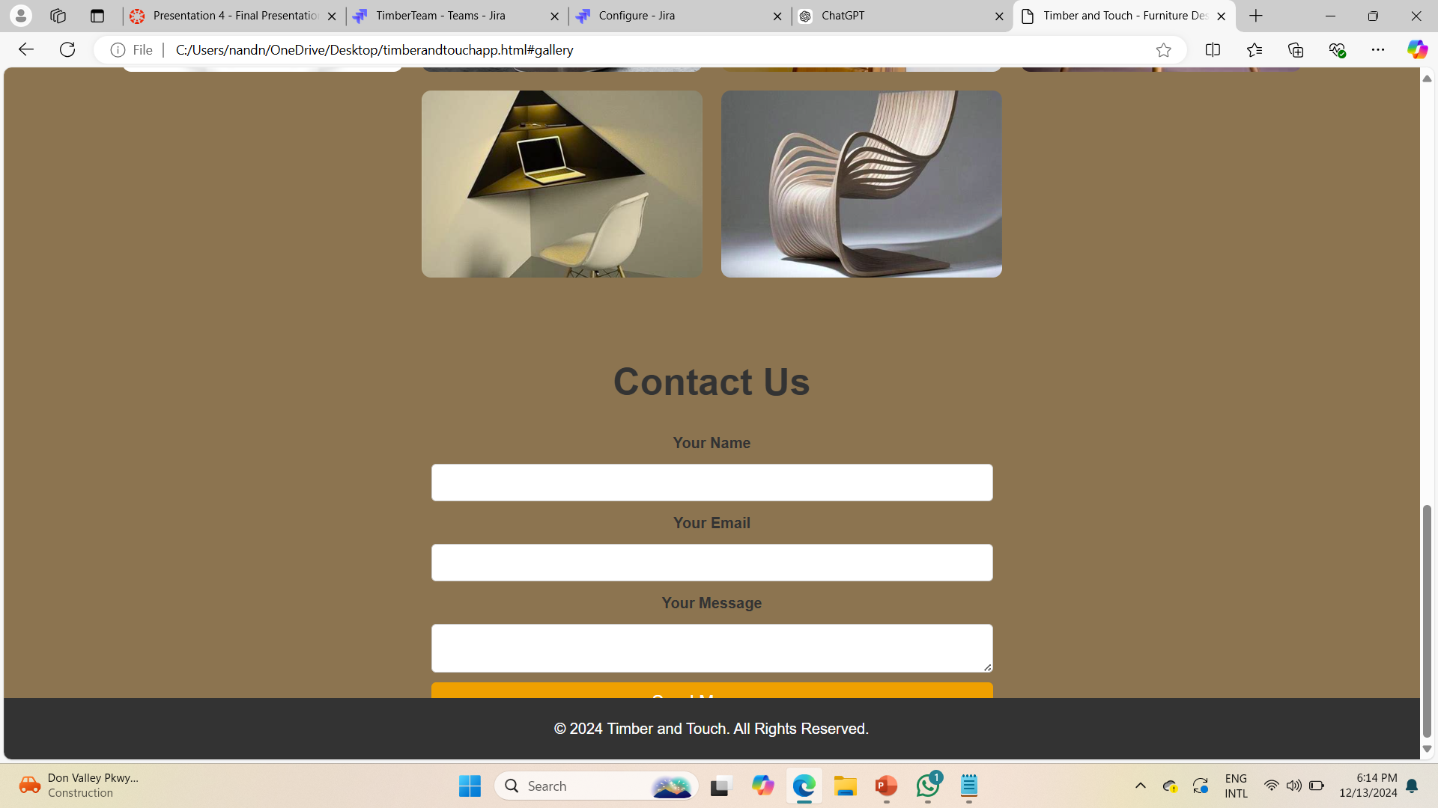
Web Page Ui

Slide 16
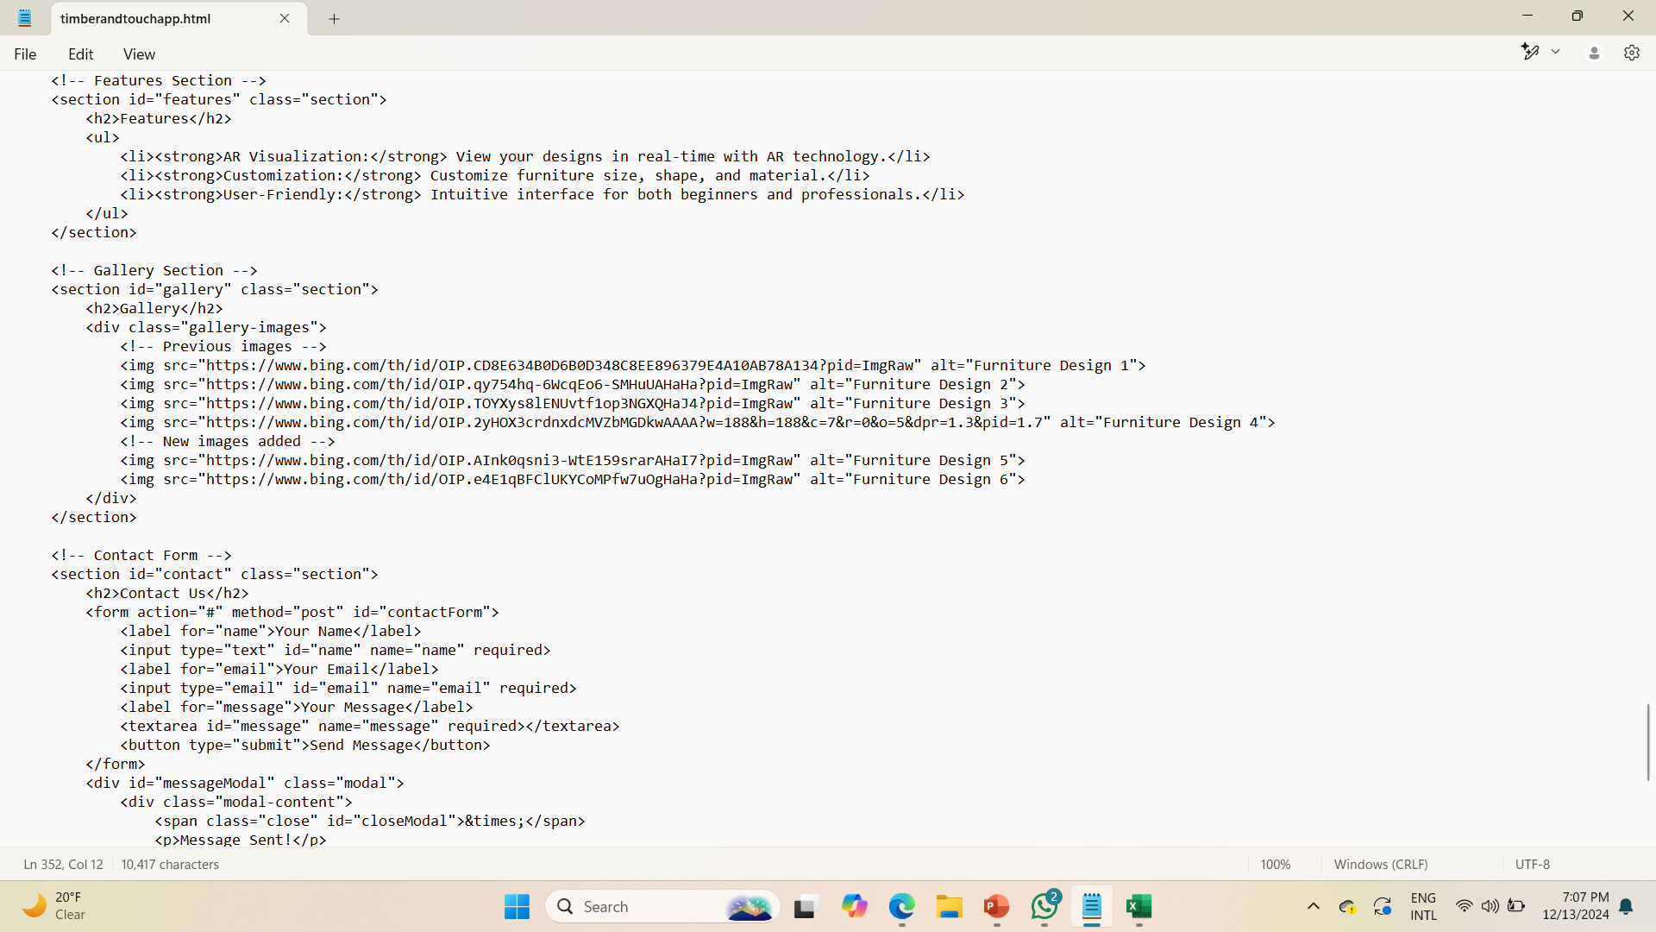
Web Page CODING

Slide 17

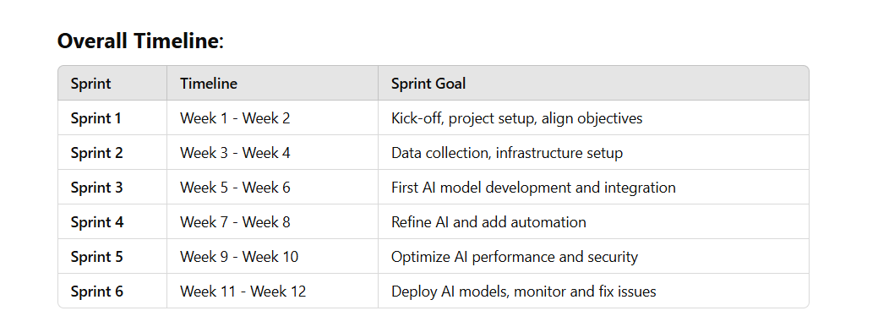
Timeline Description Using Sprints

Slide 18
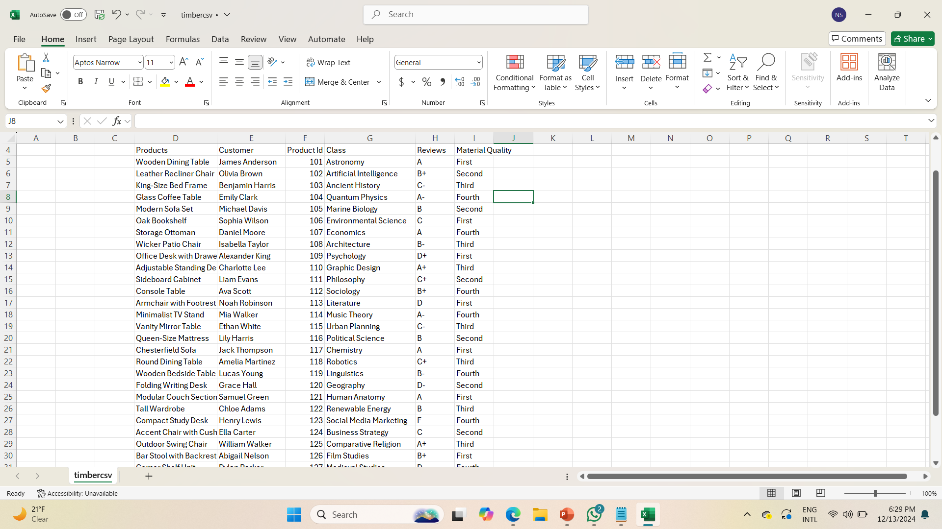
Product CSV File

Slide 19
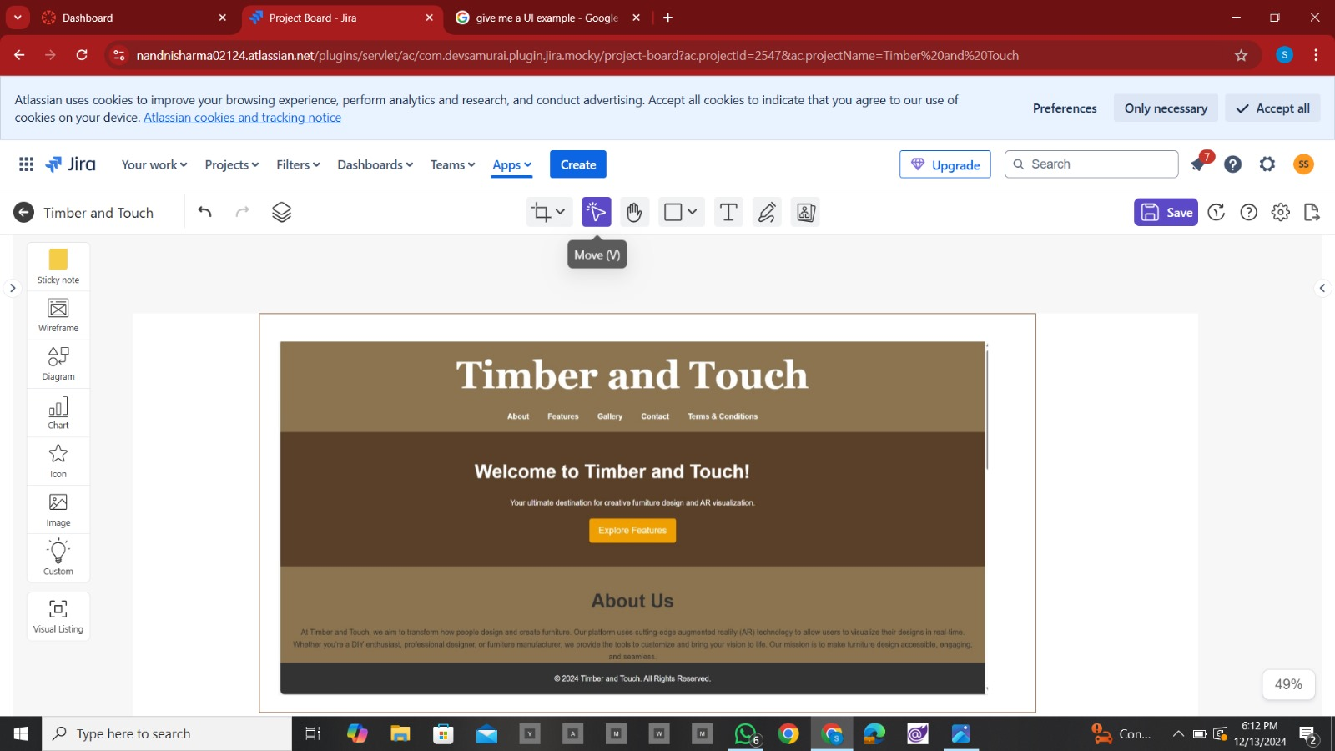
Making UI Using Wireframes

Slide 20
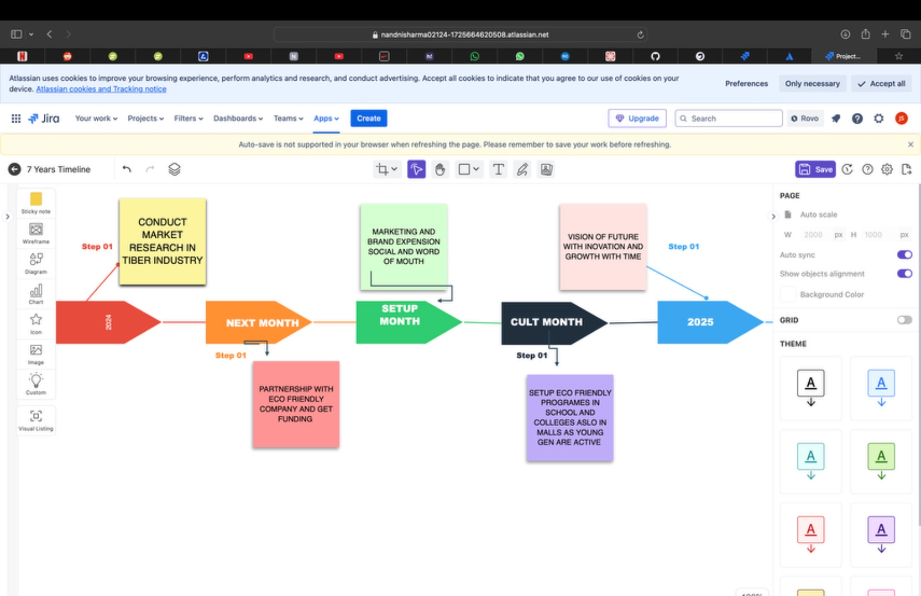
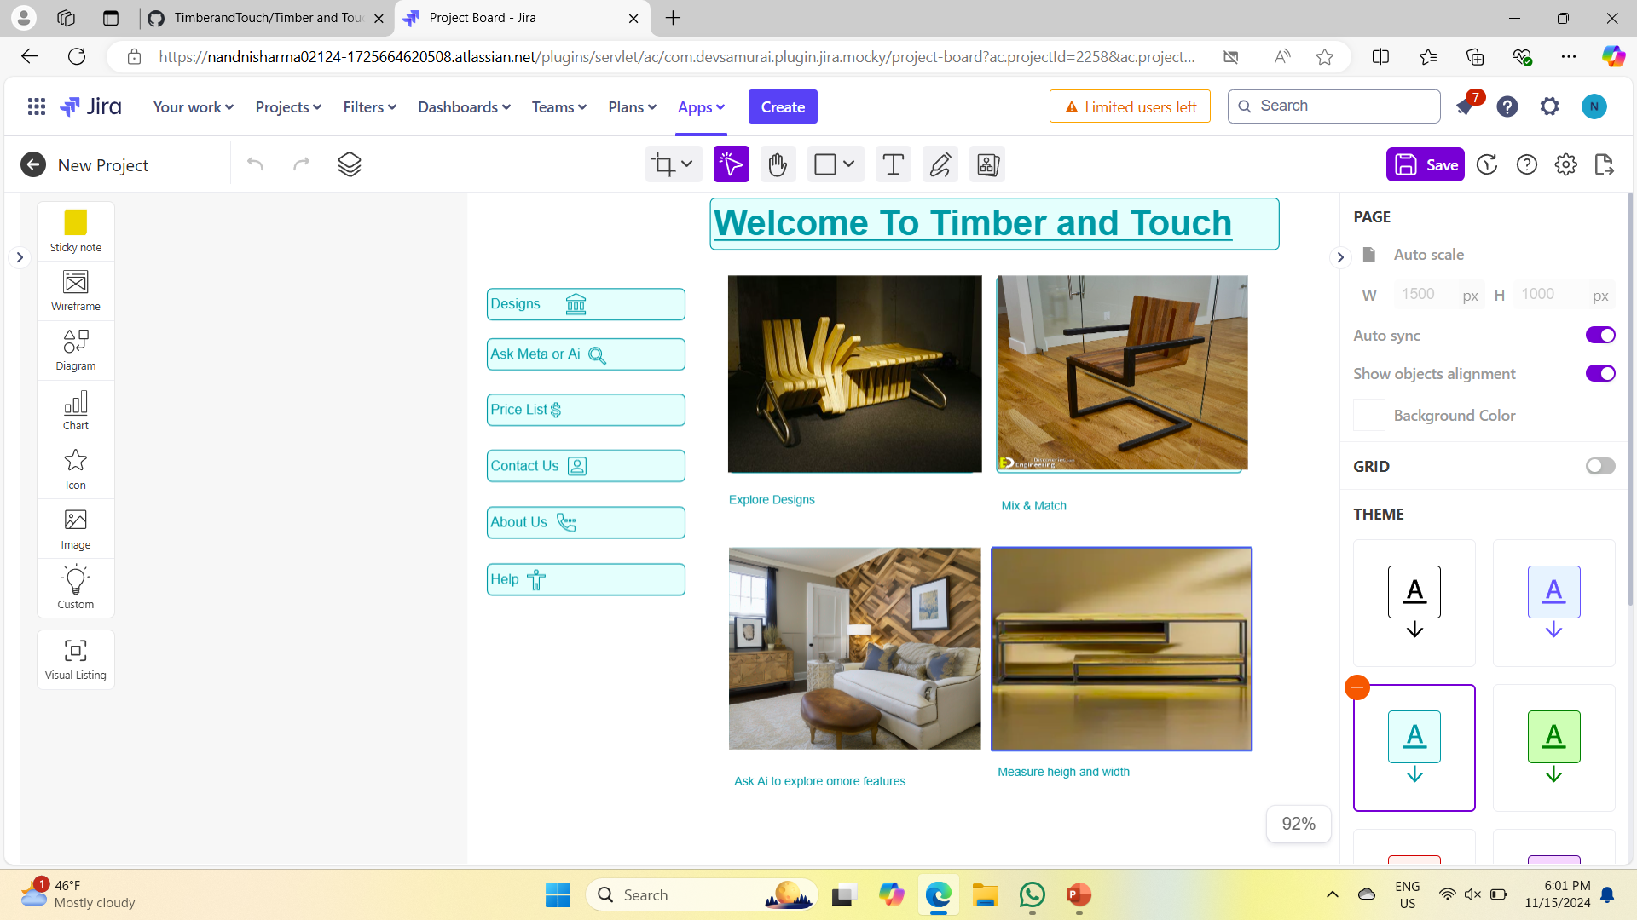
Creating UI with Wireframes

Slide 21
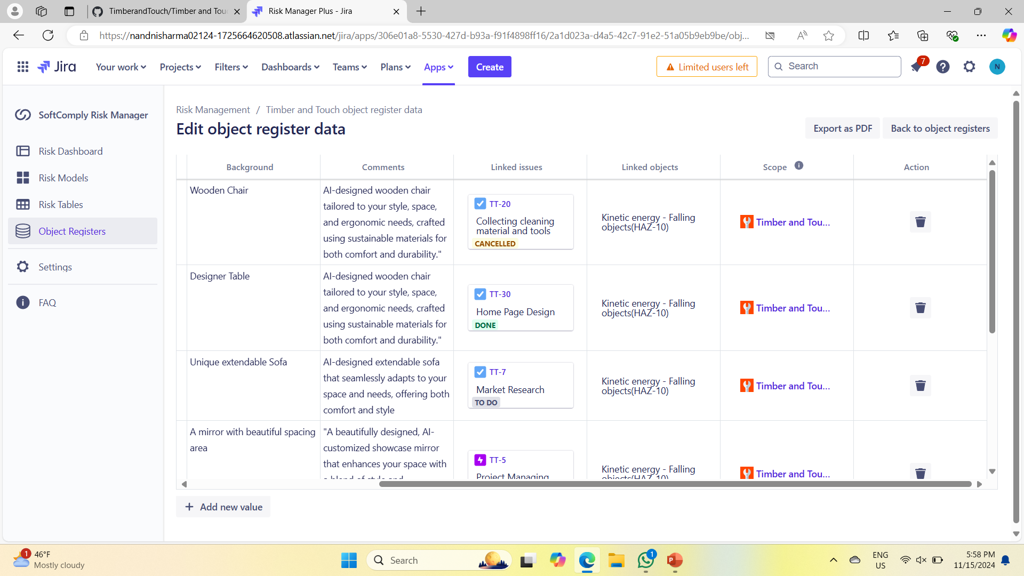
OBJECT REGISTERS

Slide 22
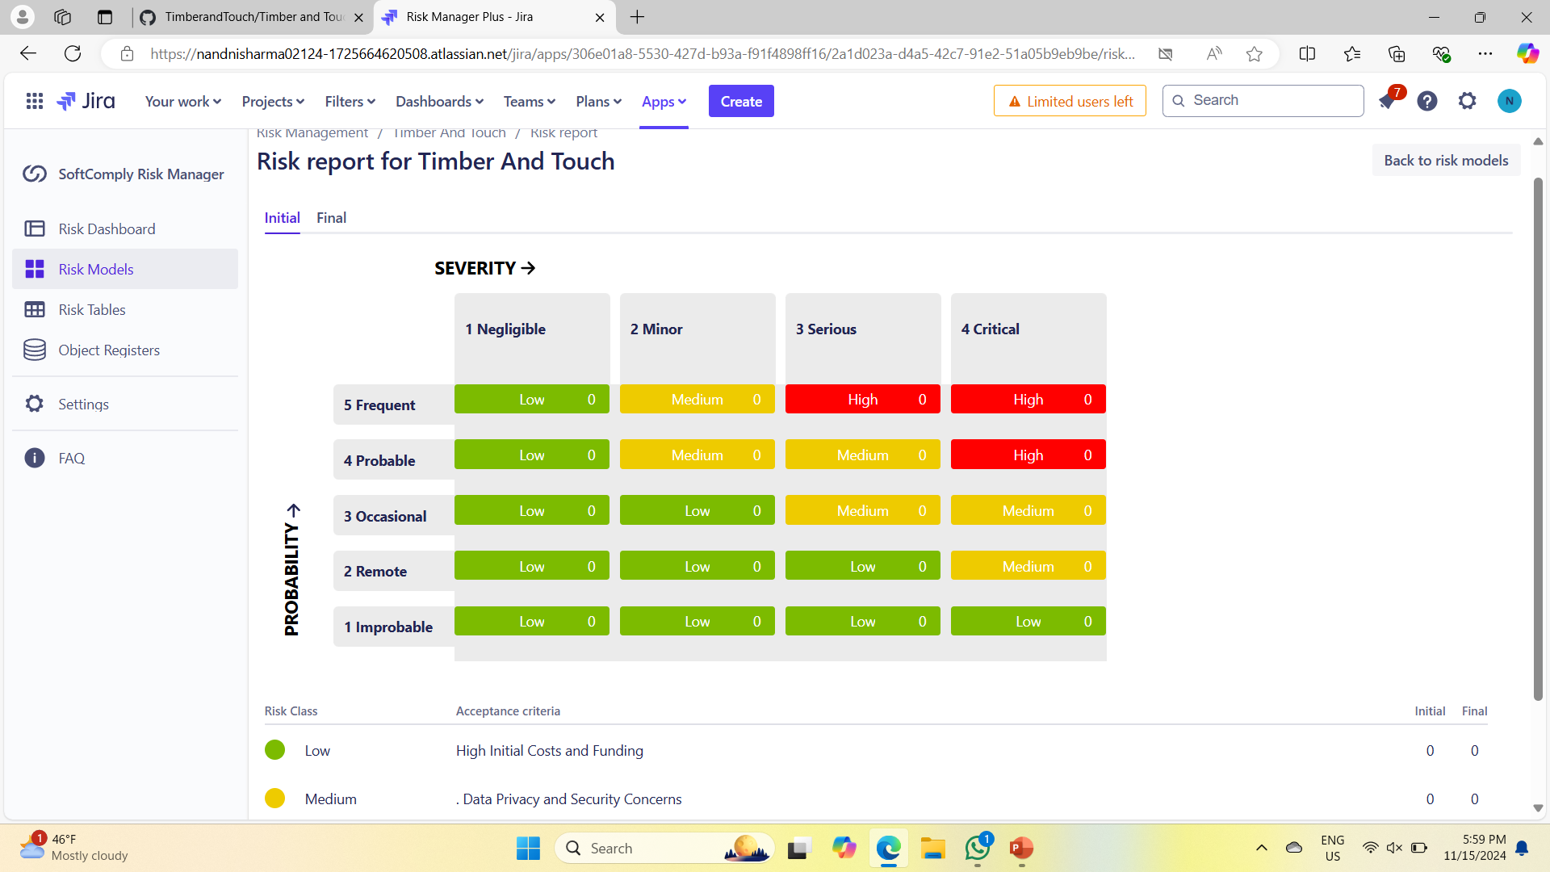
RISK REPORT

Slide 23
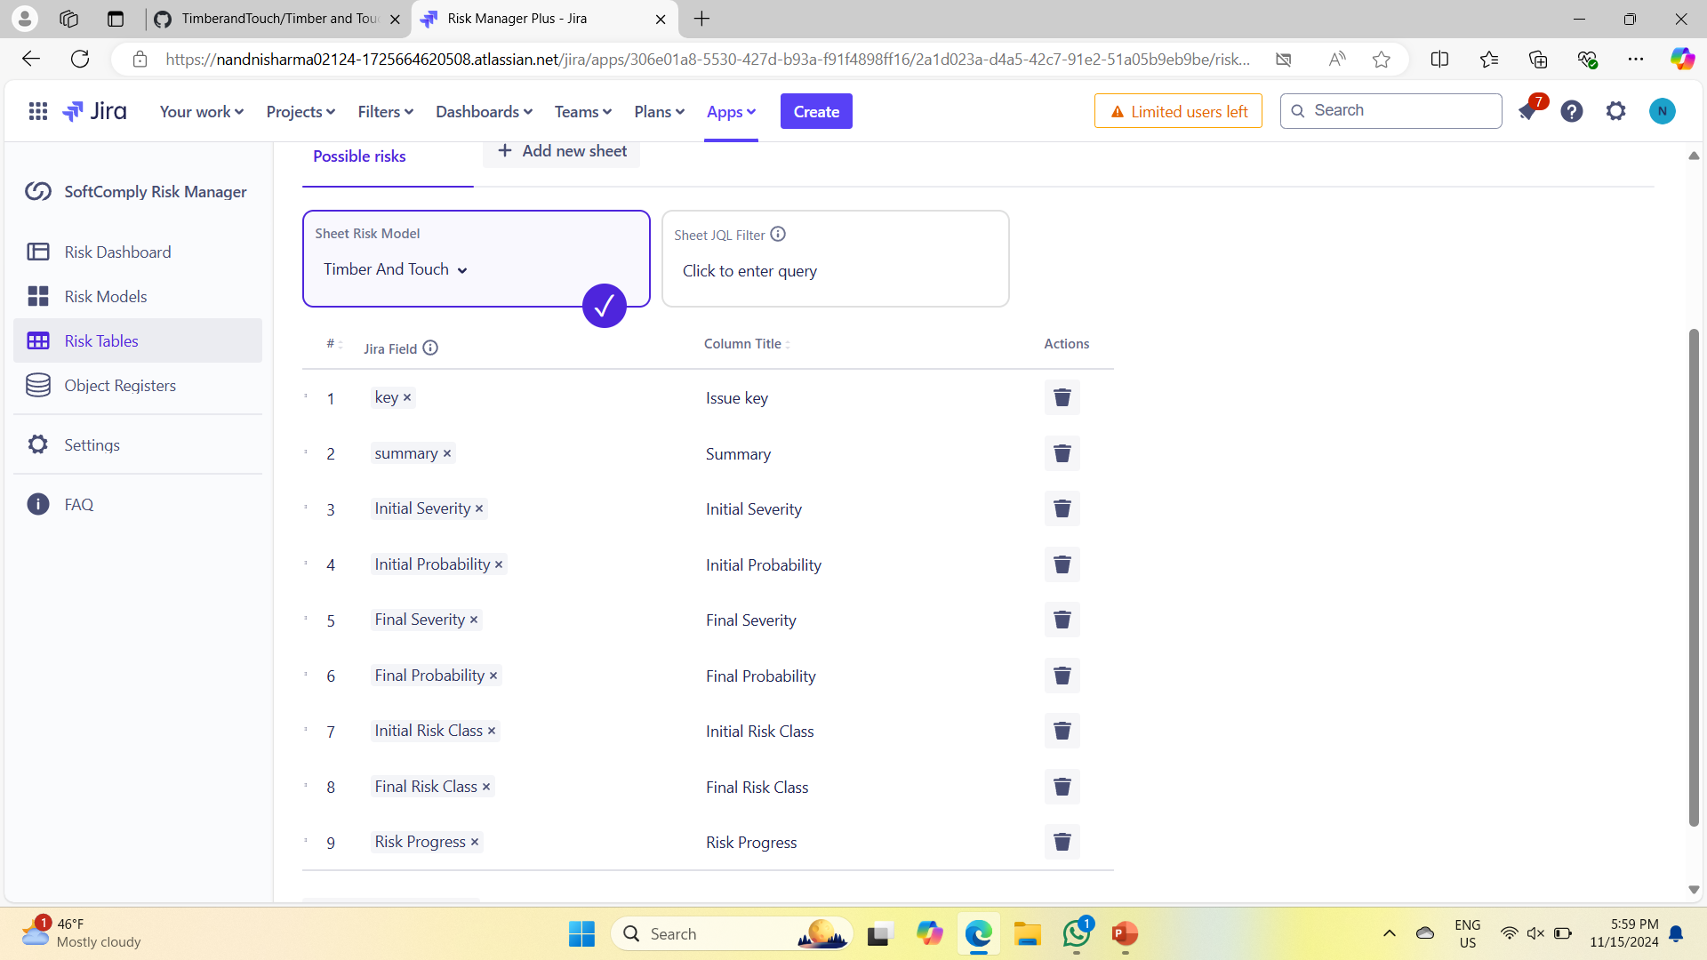
RISK TABLES

Slide 24
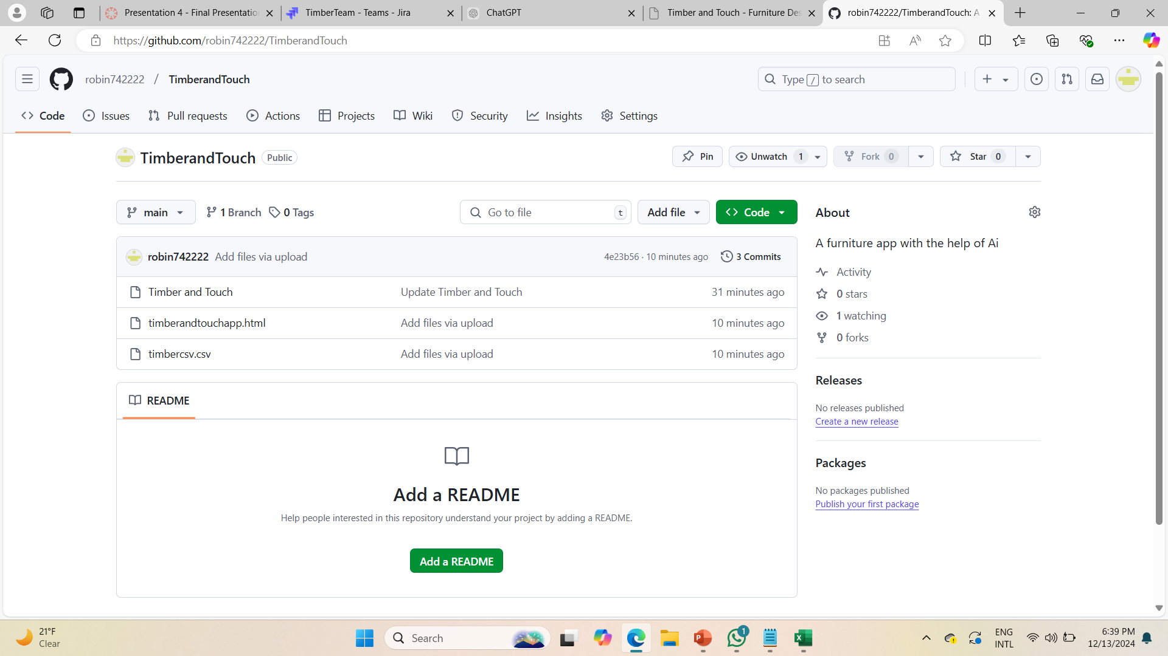
Uploading Files in github
Creating UI with Wireframes

Slide 25
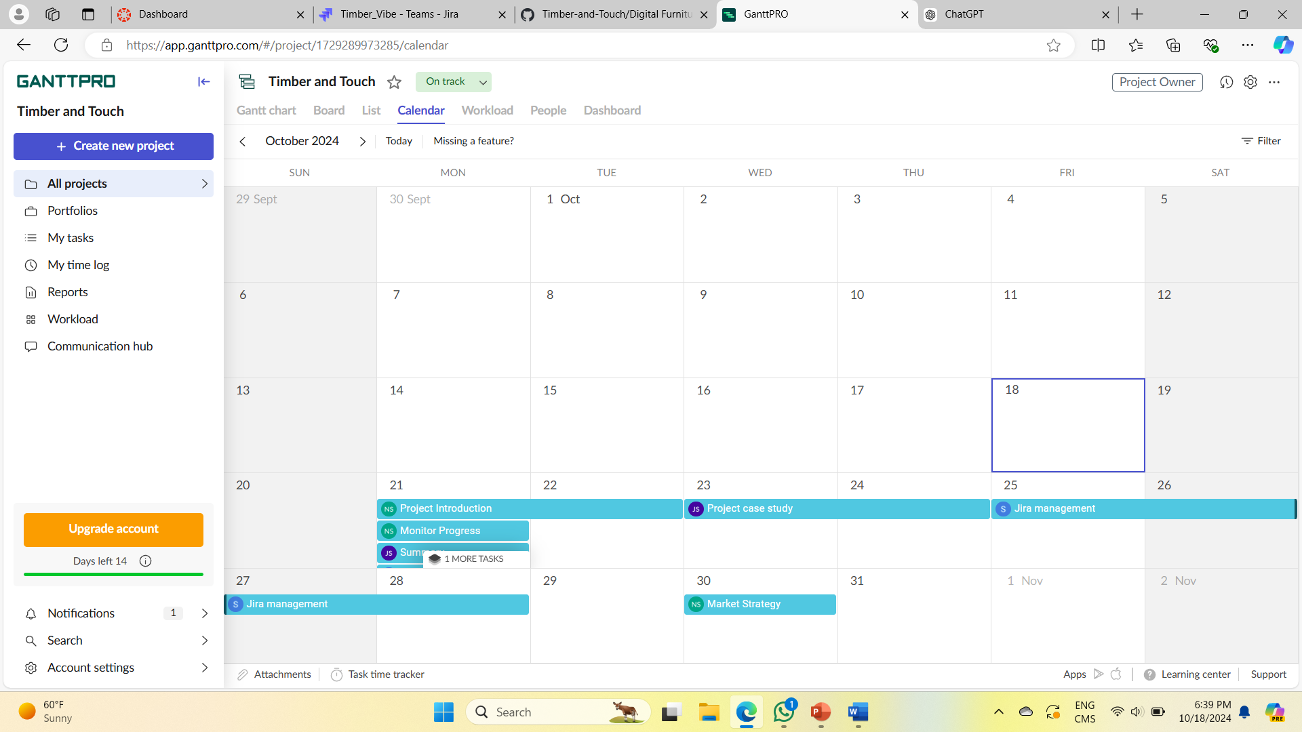
Gantt Pro

Slide 26
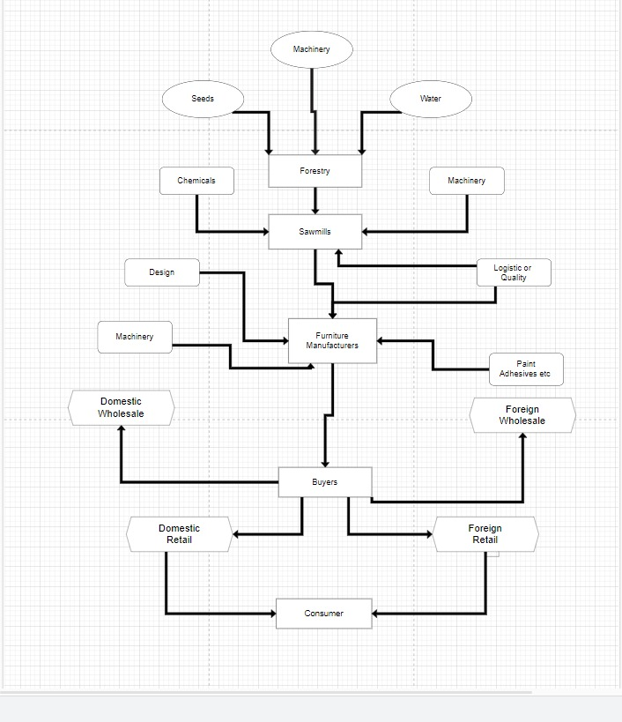
Raw Materials: This includes the wood, fabrics, and other materials used in furniture production.Machinery: The equipment and tools needed for manufacturing.
Human Resources: The workers and skilled craftsmen involved in the production process.Processes:Sourcing: The process of obtaining raw materials and machinery.Design: The creation of furniture designs, often involving CAD software and artistic input.
Manufacturing: The actual production of furniture pieces, including cutting, shaping, assembling, and finishing.Quality Control: Checking the finished products for defects and ensuring they meet quality standards.
Output:Finished Furniture: The final products ready for sale.Additional Elements:Feedback Loops: These represent the ability to gather feedback from customers and employees to improve the process.External Factors: These may include market trends, economic conditions, and regulatory requirements that can impact the business.Overall, the diagram shows how the company takes raw materials and transforms them into finished furniture products, while considering various factors that can influence the process.

Slide 27
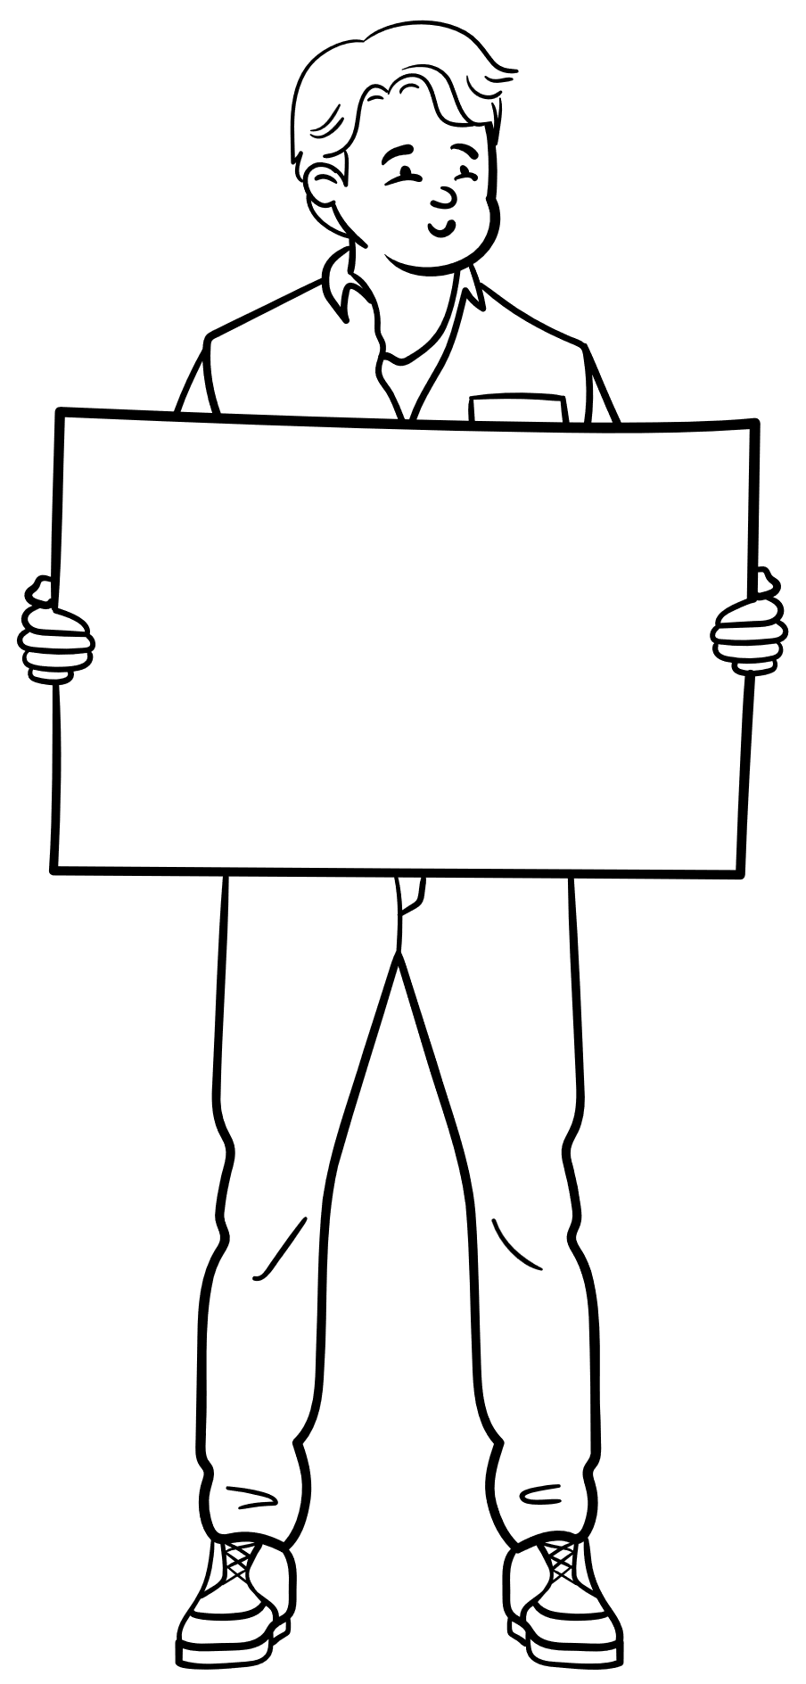
The "Timber and Touch - Furniture Design & AR" project integrates cutting-edge augmented reality (AR) technology to transform the furniture design process. We utilized various tools and methodologies to manage the project's development and ensure a successful outcome. Risk models were employed to assess potential challenges and ensure proactive solutions. An object register was maintained to track important project elements, while GitHub facilitated version control and collaboration. Project management was efficiently handled with Gantt charts, JIRA, and the Scrum framework, allowing for iterative development and timely delivery of features. Design and architecture were planned using Pro Draw.io and SketchUp, providing a clear and detailed view of the system and its components. The Web UI was crafted to be user-friendly and visually appealing, ensuring seamless navigation for users to customize and visualize their furniture designs. This integrated approach enabled us to deliver a high-quality product that bridges the gap between traditional furniture design and innovative AR technology.
SUMMARY

Slide 28
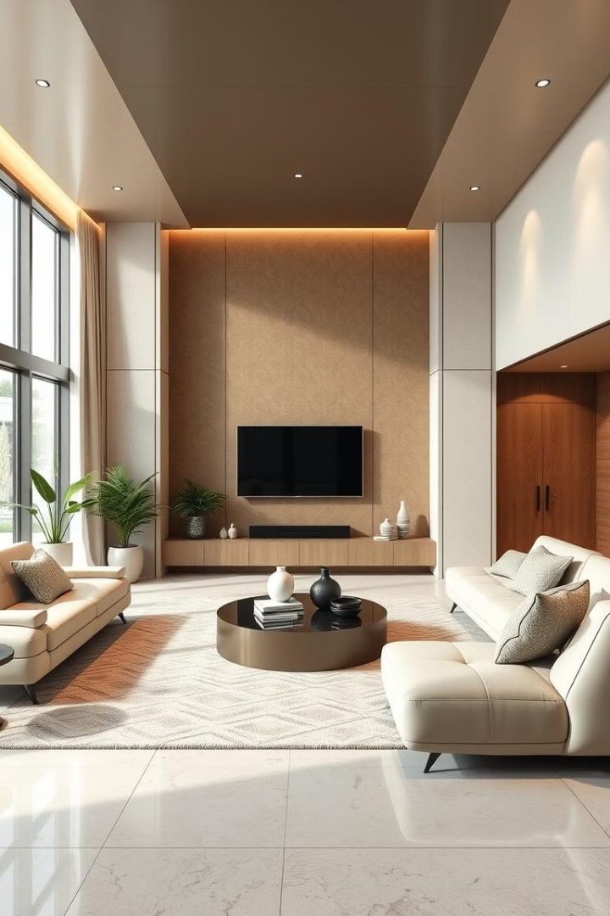
The Future of Timber and Touch
100+
New Designs
Expanding our product portfolio with innovative furniture designs that cater to diverse lifestyles.
50%
Global Expansion
Expanding our reach into new markets, bringing AI-designed furniture to a wider audience.
1M+
Customer Satisfaction
Building a strong customer base by providing exceptional design, quality, and service.

Slide 29
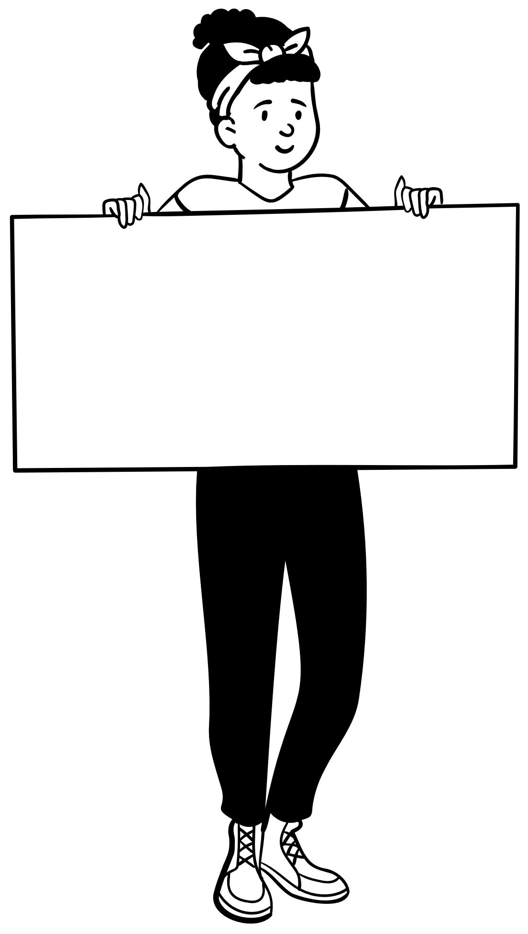
In conclusion, the Timber and Touch project successfully leverages augmented reality to revolutionize the furniture design and manufacturing process. By combining intuitive customization tools with real-time visualization, the app empowers users—from DIY enthusiasts to professionals—to create and visualize their furniture designs with ease. Throughout the project, we addressed challenges related to AR integration, design aesthetics, and user experience, ensuring the final product met the needs of our target audience. With continuous testing and refinement, Timber and Touch is poised to offer a seamless and innovative solution for modern furniture design.
Conclusion

Slide 30

Thank You

